Slide 1
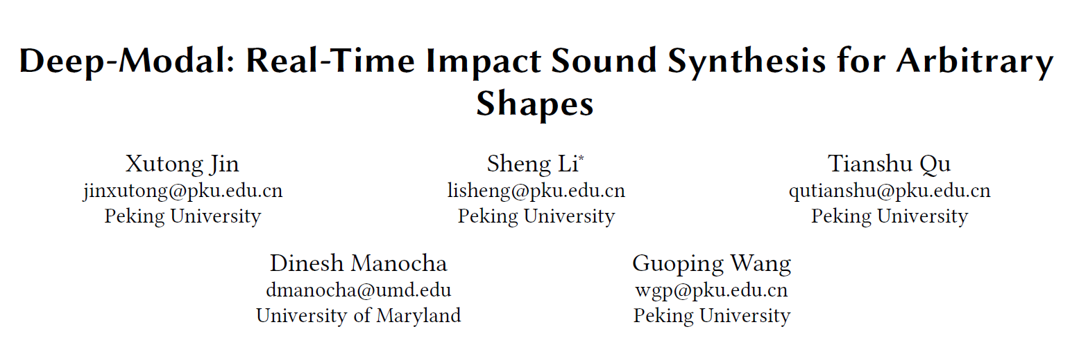



Slide 2
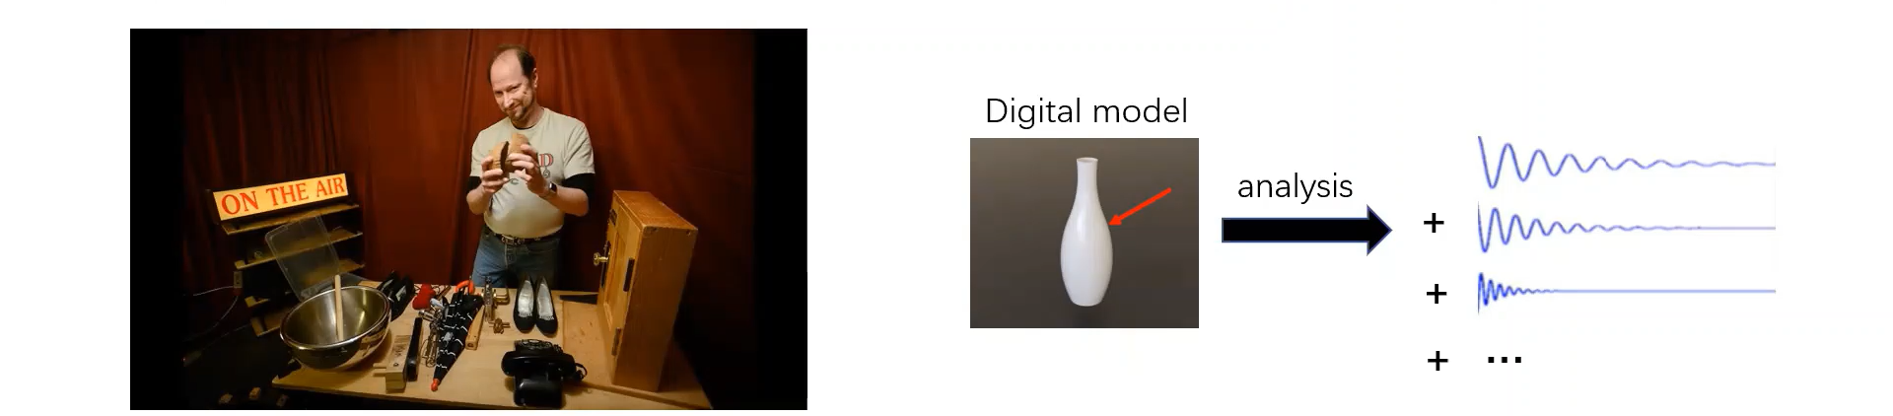
Background
Sound in virtual environment and media content generation
Foley sound
Physically-based sound synthesis method
From the Columbian newspaper

Slide 3
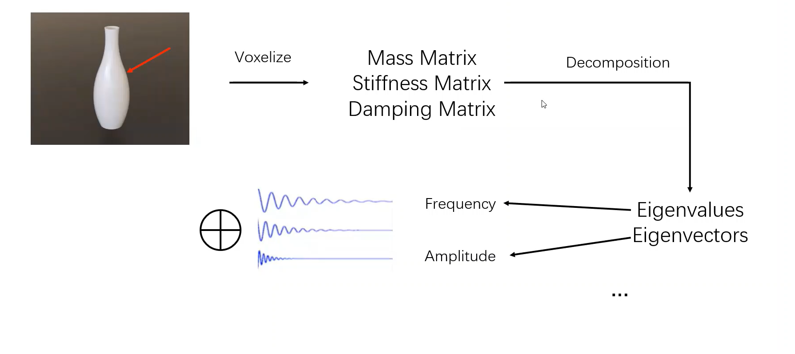
Modal Synthesis

Slide 4
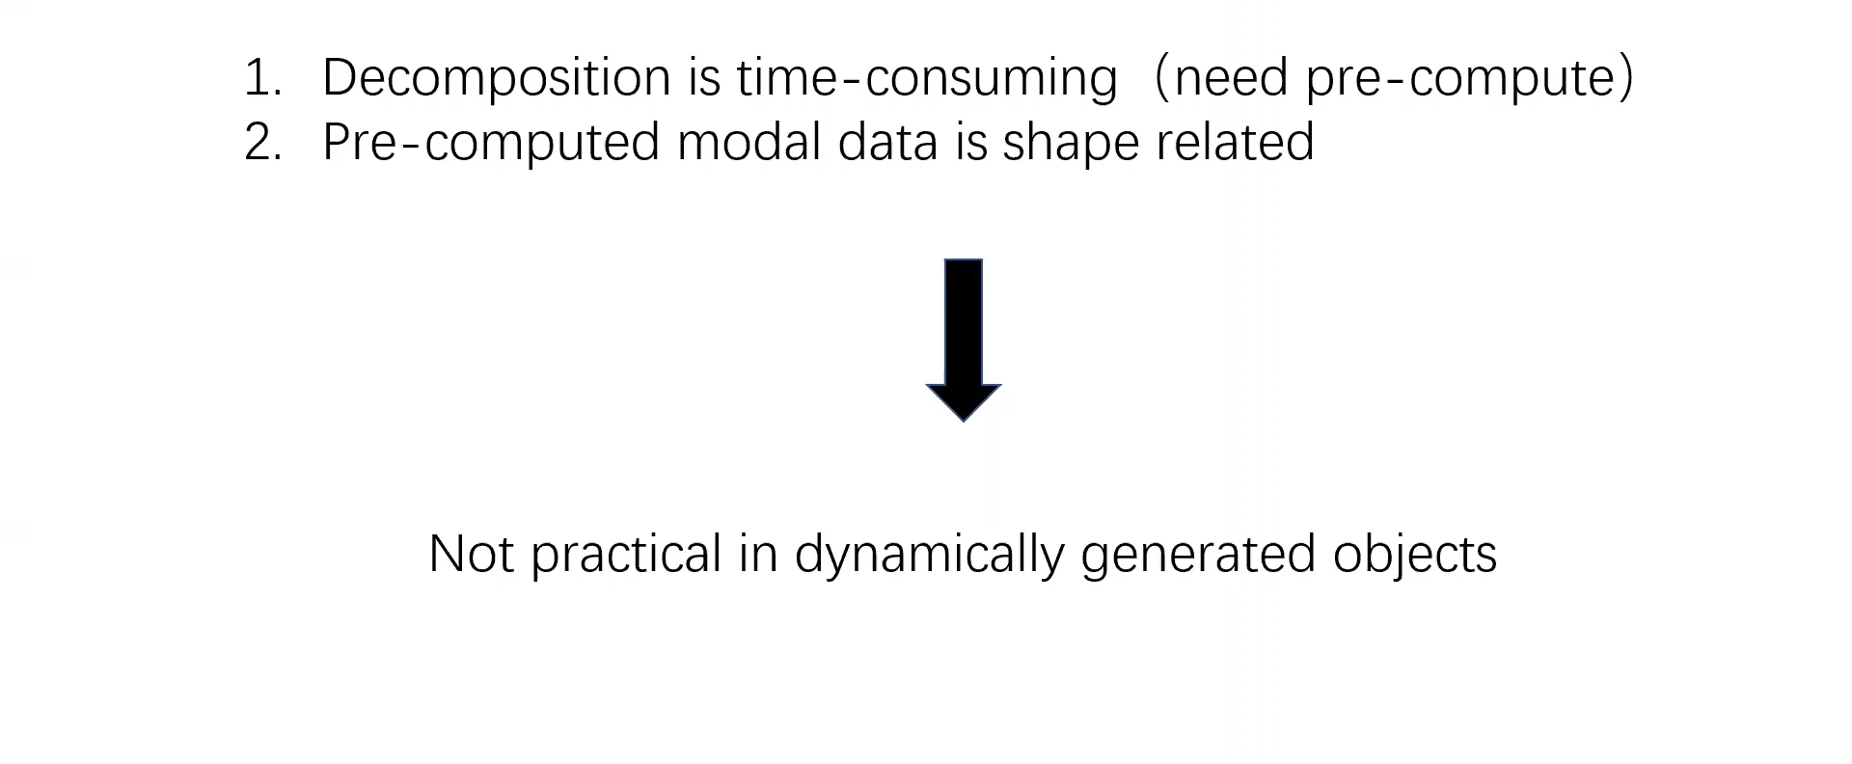
Limitations of Modal Synthesis

Slide 5
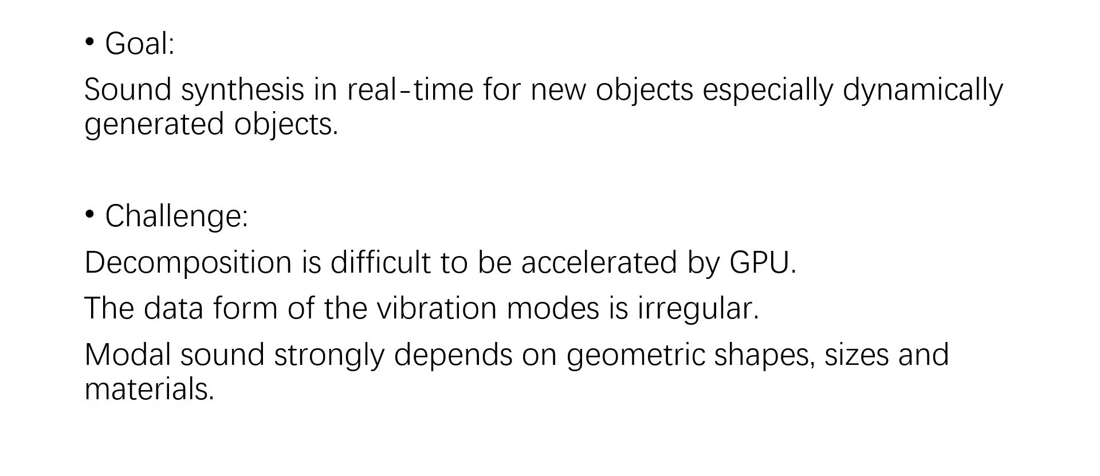
Our Work

Slide 6
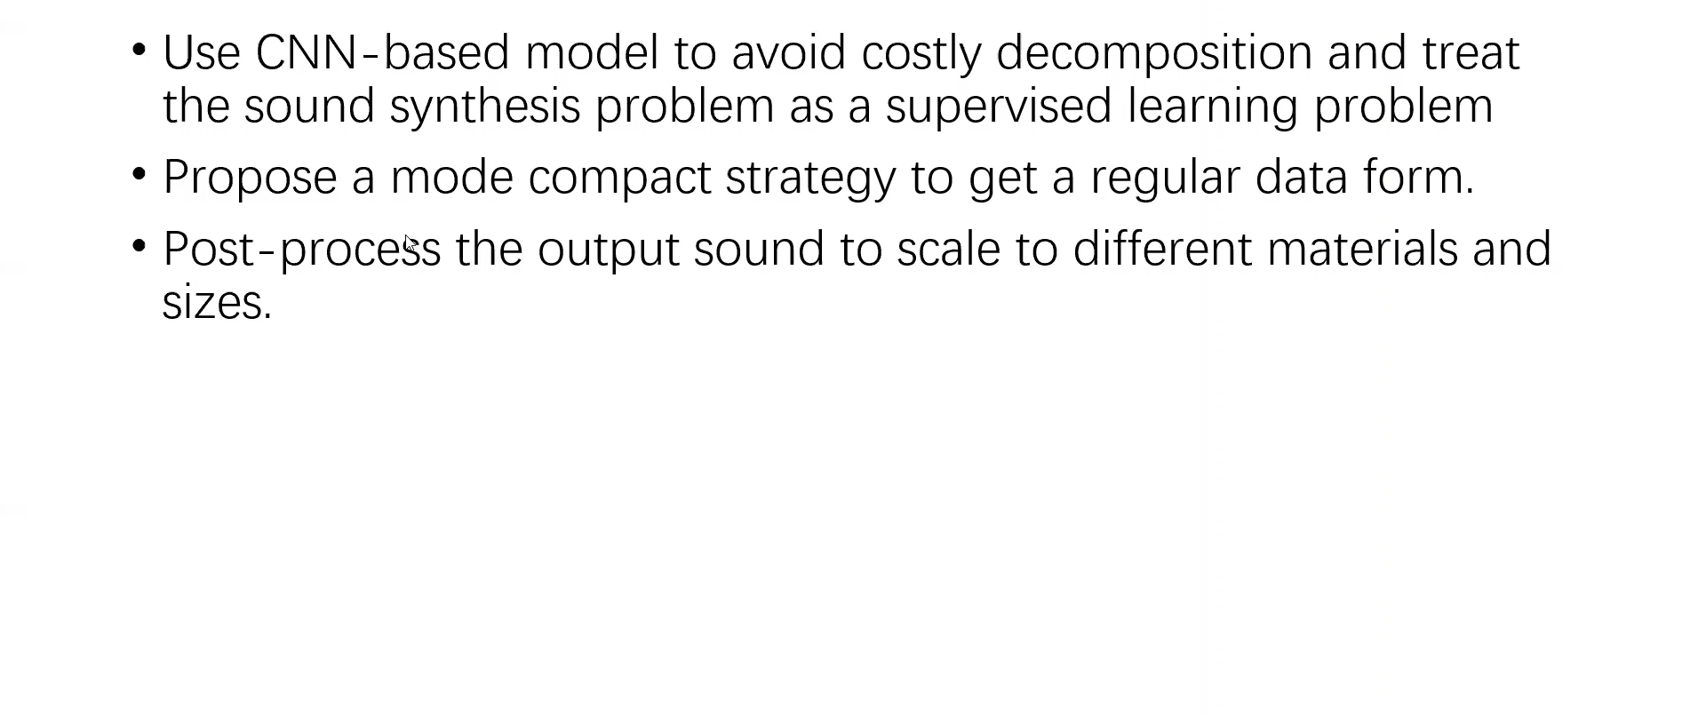
Our Solution

Slide 7
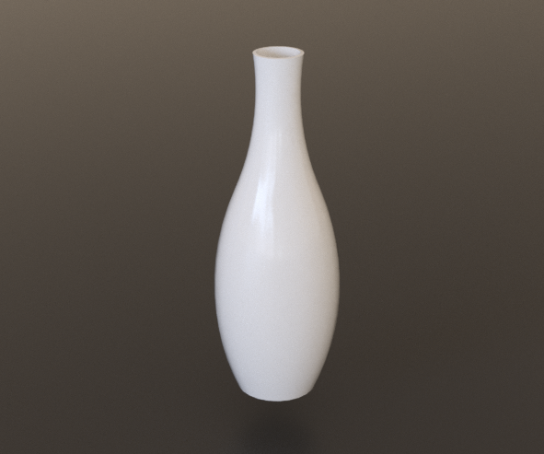
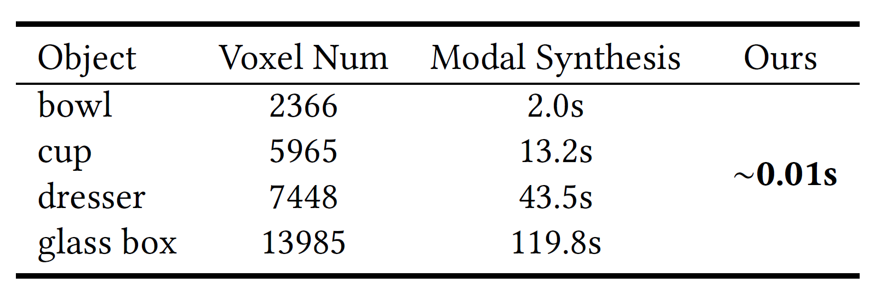
Deep-Modal
Frequency
CNN-based Model
Voxelize
Amplitude

Slide 8
amp
Modes
Mel scale
Pack
amp
Compact
Modes
Need to fix the length of the vector
Avoid over-smoothed results
Mel scale
amp
Representation
Amplitude
Mel scale
Mask
Mel scale

Slide 9
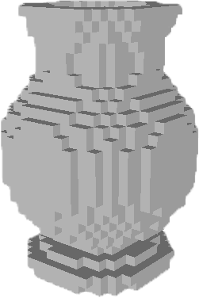
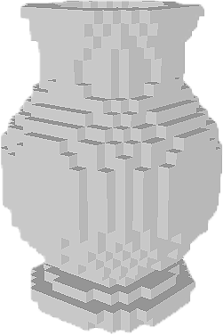
Encoder-Decoder Network
Voxelized model
Contact
Position
[Zheng, C., James, D. 2010]
[Ren, Z., Yeh, H., and Lin, M. C. 2012]
Post-processing
Compact
Modes
Output

Slide 10
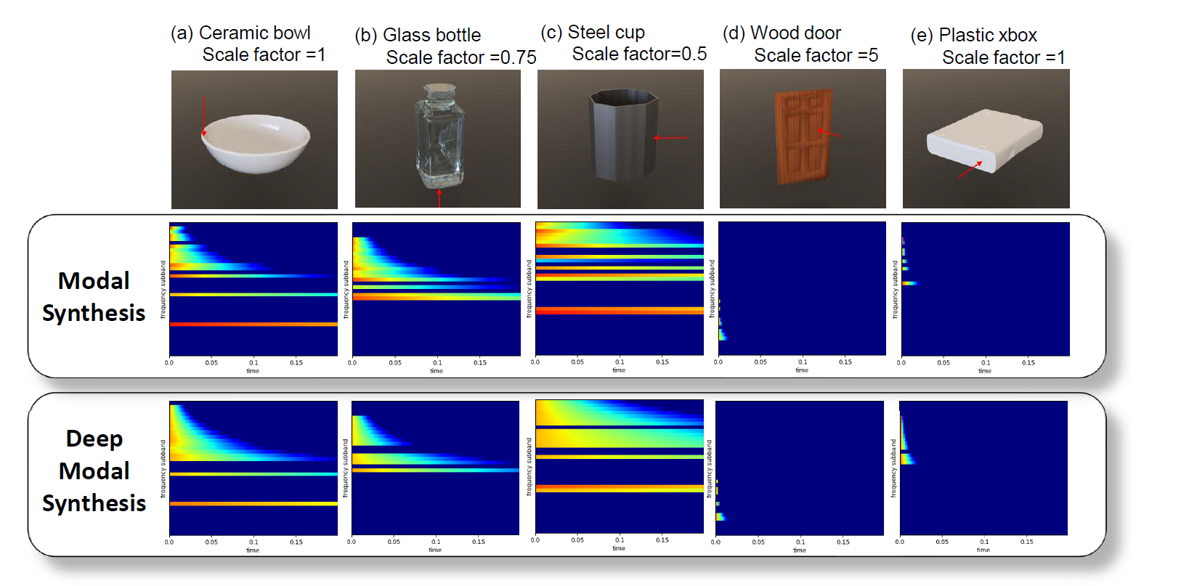
Evaluation

Slide 11
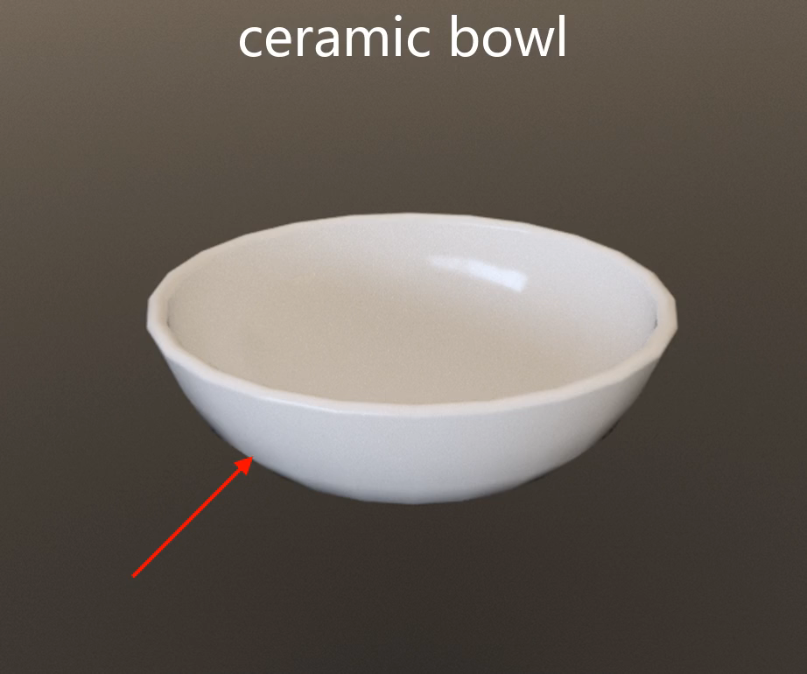
Comparison 1
Ground-truth
Our result

Slide 12
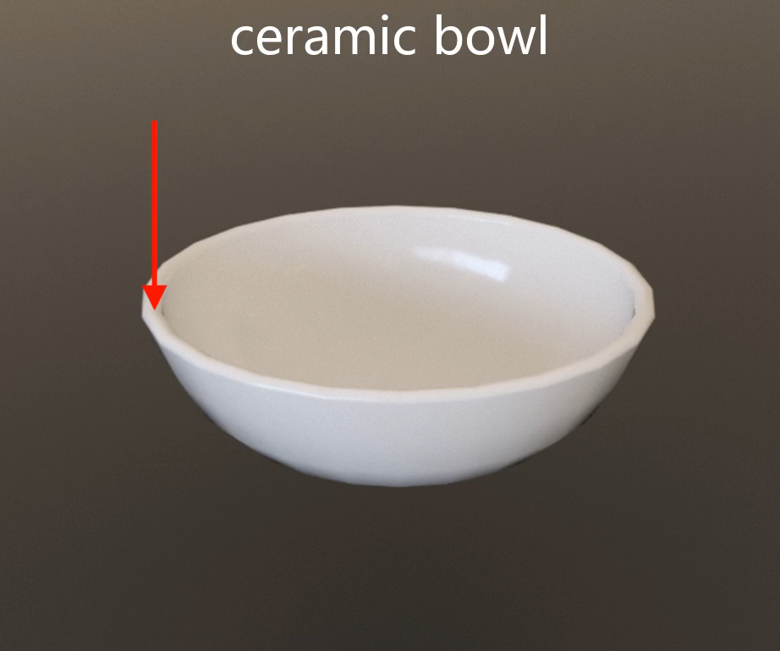
Comparison 2
Ground-truth
Our result

Slide 13
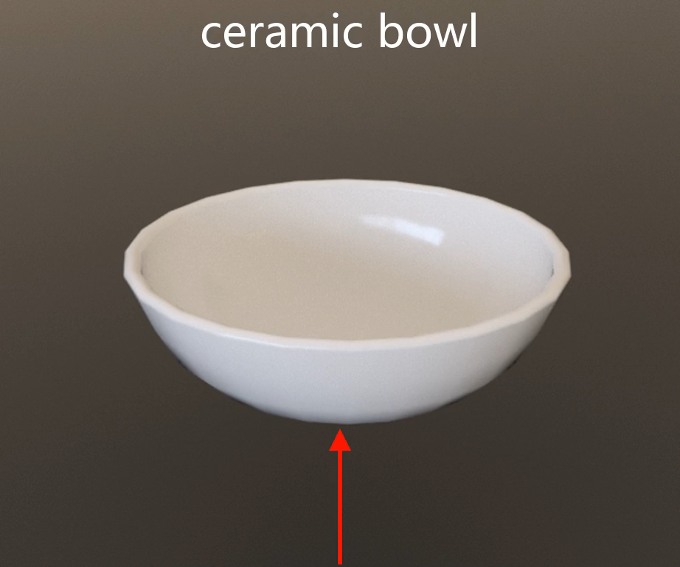
Comparison 1
Ground-truth
Our result

Slide 14
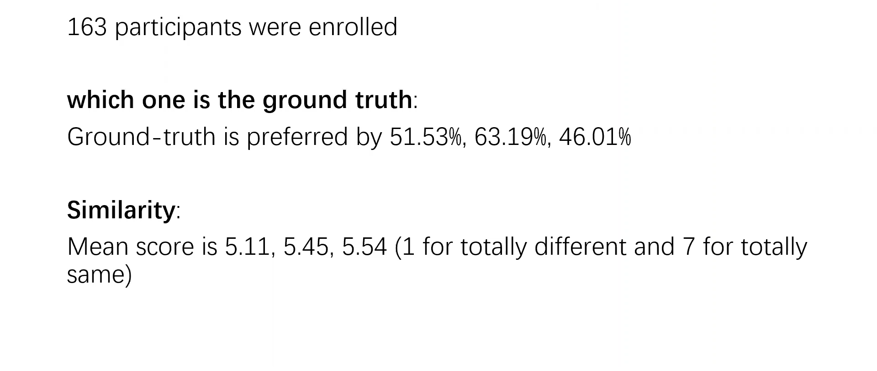
User Study

Slide 15
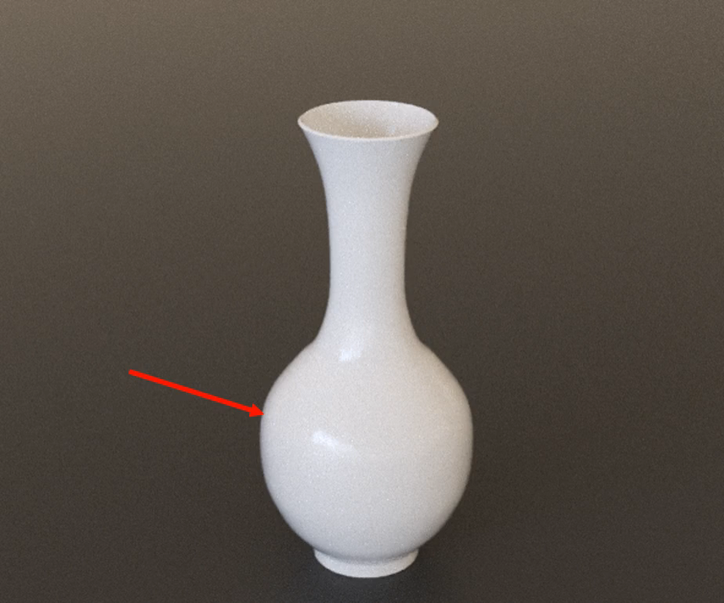
A Fractured Scene

Slide 16
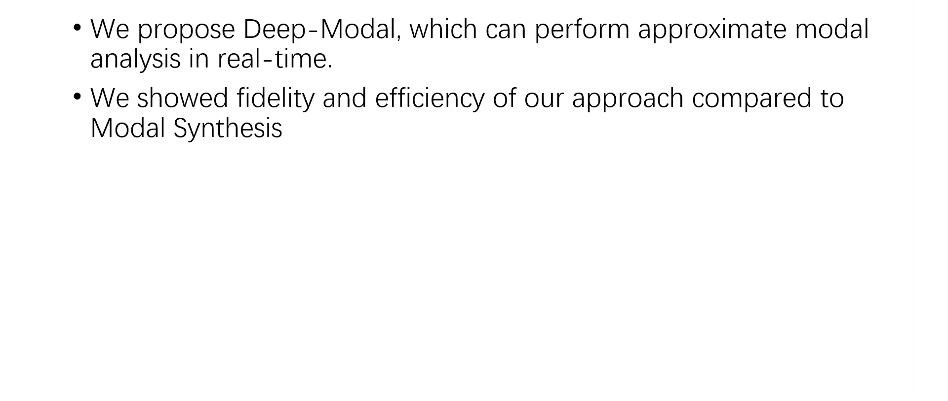
Conclusion

Slide 17
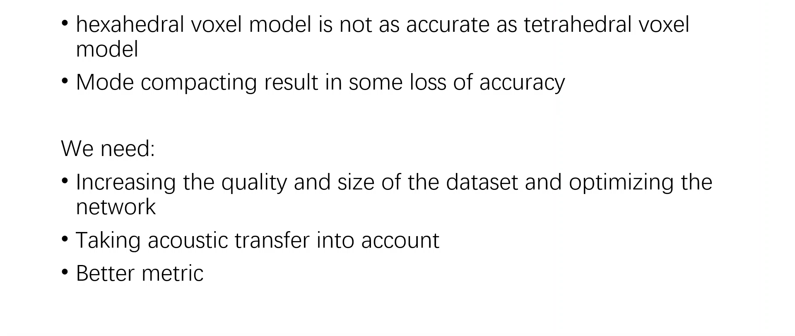
Limitation and Future Work

Slide 18
End
Thanks!

